Slide 1
Image Warping
Project 3

Slide 2
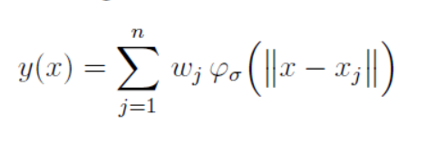

Task 3.1
Radial Basis Function Interpolation
Weighted Linear combination of Radial basis function

Slide 3
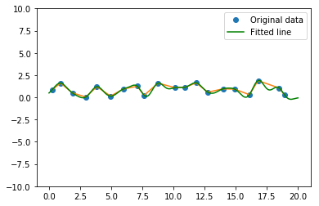
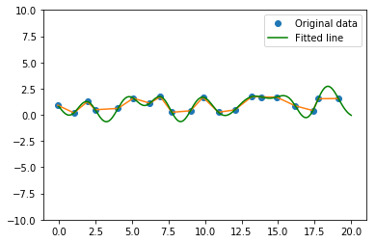
Task 3.1
Interpolation result for different σ
σ = 0.5 σ = 1.0

Slide 4
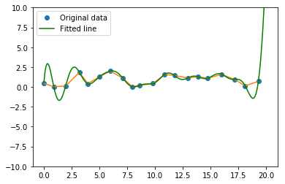
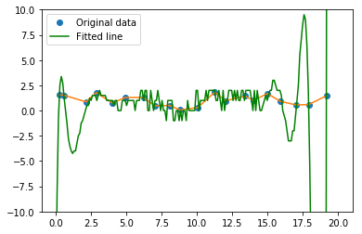
Task 3.1
Interpolation result for different σ (cont.)
σ = 2 σ = 4

Slide 5
Task 3.2
Implement Wave function on the image
Experiment with different parameterizations

Slide 6
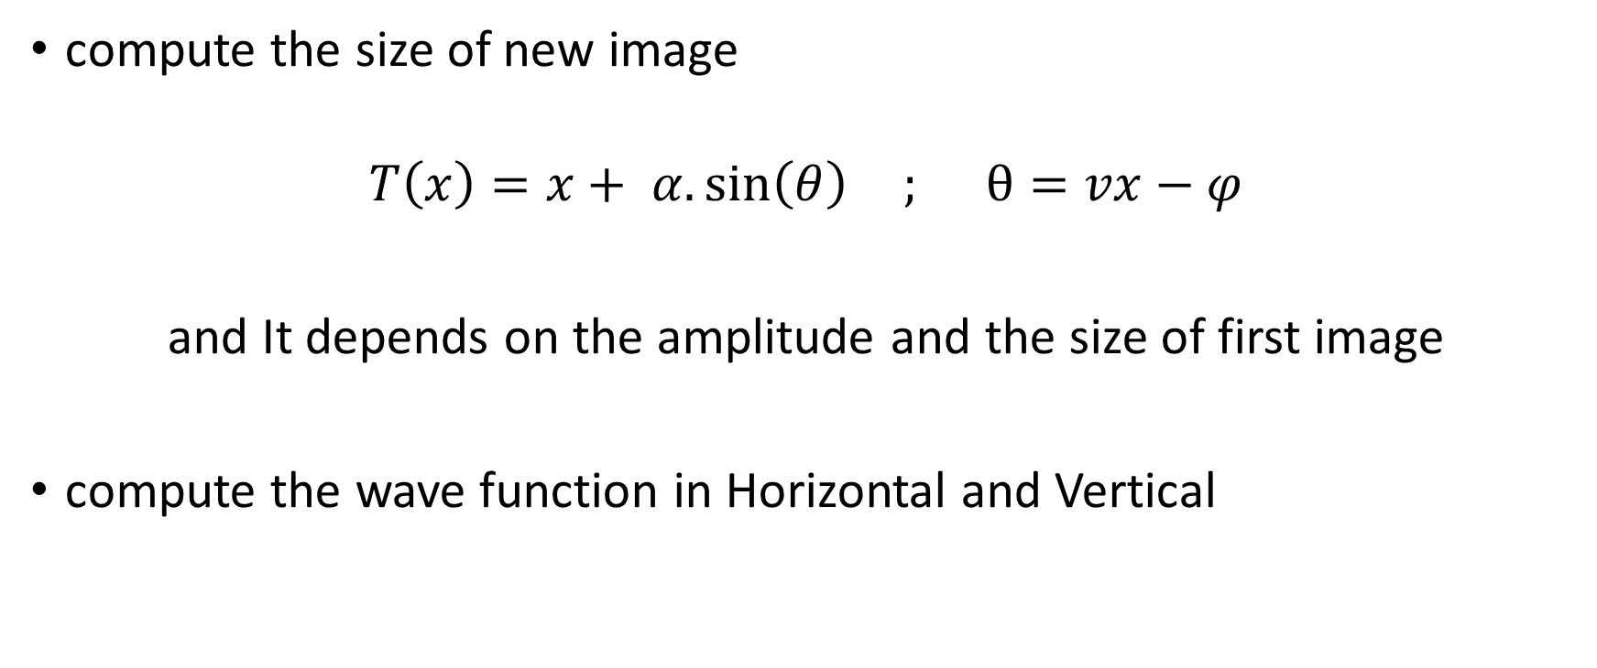

Slide 7
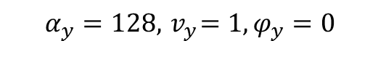
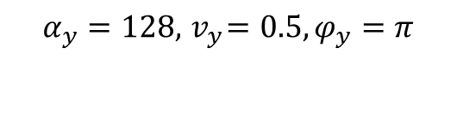

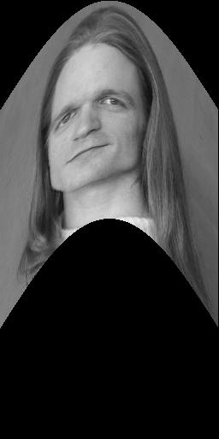
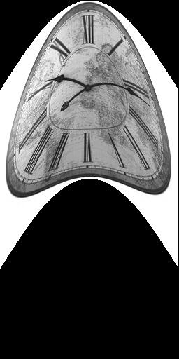
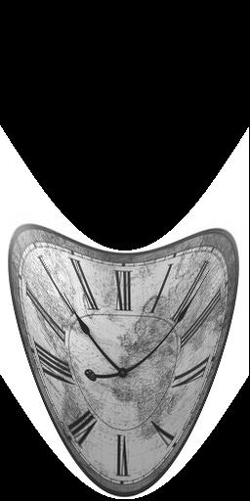
Results :

Slide 8
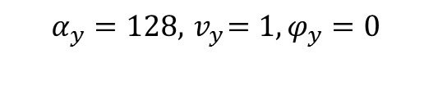
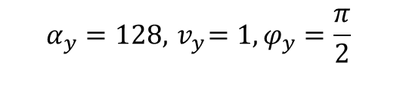
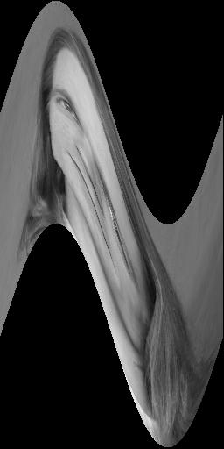
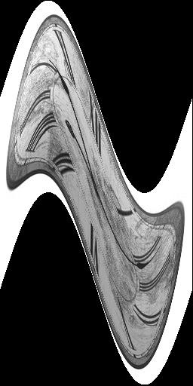
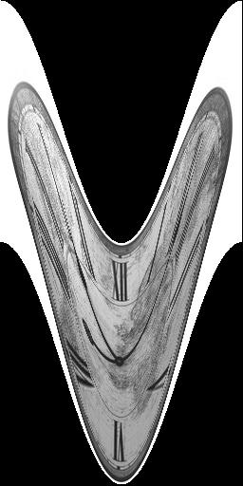

Slide 9
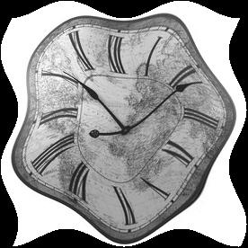
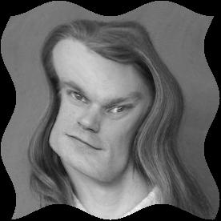
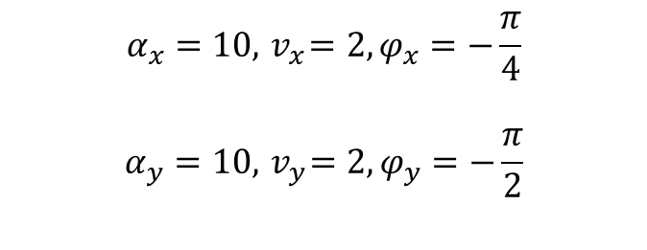

Slide 10
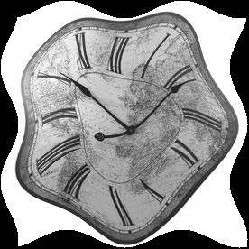
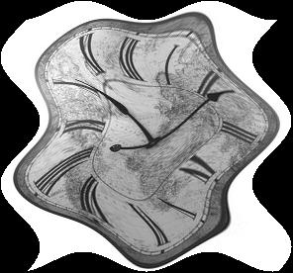


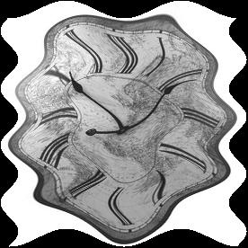


Slide 11
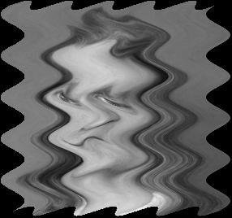
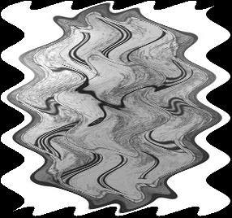


Slide 12
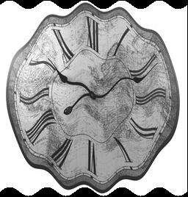
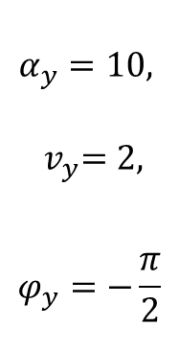
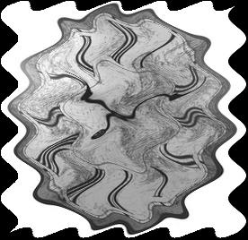
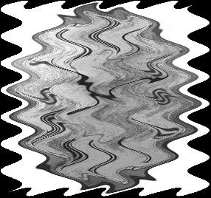
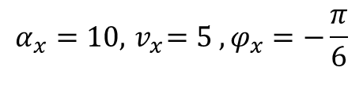


Slide 13
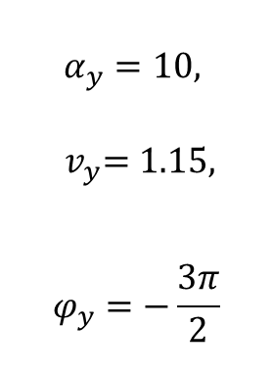
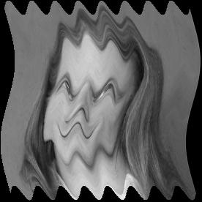
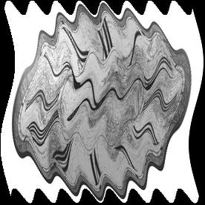

Slide 14
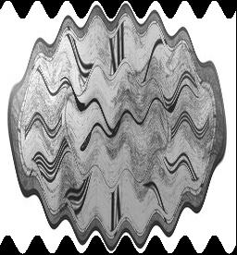
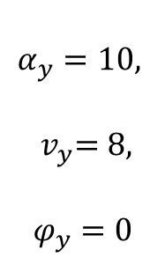
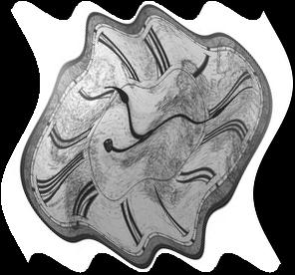
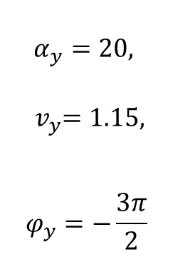
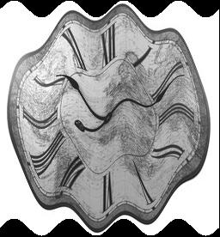
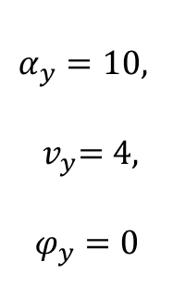

Slide 15
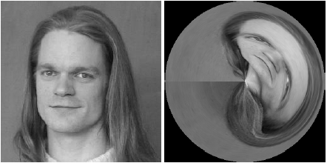
Task 3.3
Requirements: In this task we are required to perform a anamorphic image warping, and a discs-like extension of it. Apply this on clock.jpg.

Slide 16
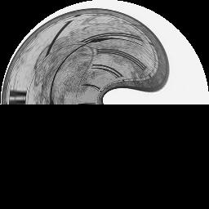
Task 3.3
Method: To achieve this, we need to map the image from r, 𝜑 plane onto the x, y plane using from_r_phi_plane_V2.
Set the rmax and phimax as a circle:
rmax = n/2
phimax = np.pi * 2
Shift the coordinates by n/2, m/2 to put image in the center:
np.meshgrid(np.arange(n) - n/2, np.arange(m) - m/2, sparse=True)
rotate 𝜑 by adding 𝜋
phis = phis + np.pi
Rotate the image for the correct origin
f = np.rot90(f)
Extension: radial discs:
rs = rs - rmin

Slide 17
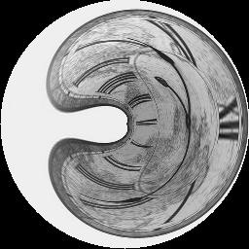
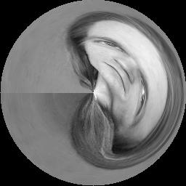
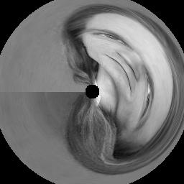
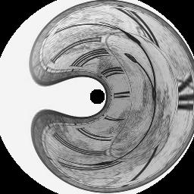
Task 3.3
Results:

Slide 18

Task 3.4 Apply 1D Gaussian on the to Polar representation of the image.
Represent the image in polar coordinates(r,ⲫ) instead of (x,y):
Take Grid(r,ⲫ) -> convert to planar (xs,ys) -> map to image(x,y) to get (r,ⲫ)
2. Apply Gaussian smoothing in one direction row wise or column wise to create the desired effect.
3. Convert the image back to the cartesian format.
Take Grid(x,y) -> convert to polar (rs,fis) -> map to image(r,ⲫ) to get (x,y)

Slide 19
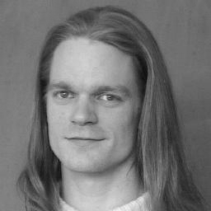
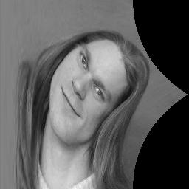
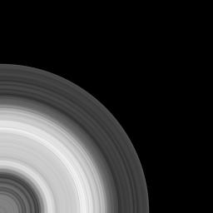

Representing in polar and back to planer
ⲫ
r
Planar
Polar
Naively Converted Back
Properly Done

Slide 20
There’s a catch here:
We need to correctly spread the rs and fis value we get to all rows and cols properly.
iis = (fis/fimax)*(rows-1)
jjs = (rs/rmax)*(cols-1)
2. Second in this case arctan2 returns values in [-𝝅,𝝅], we need to add 2𝝅 to correctly map negative values.

Slide 21
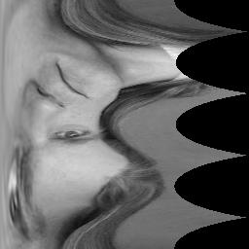
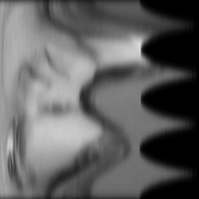
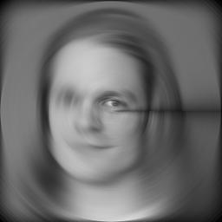
After handling both situations correctly:
Normal
Polar
Vertical Direction
Gaussian Smoothing
Converted Back
This artifact is generated due to improper handling of border pixel’s in vertical direction. If we choose wrap around option while convolving it goes away.

Slide 22








y
x
ⲫ
r
Row wise Gaussian
Col wise Gaussian
Both dir Gaussian

Slide 23






Sigma: 3 5 7 11

Slide 24








Sigma: 3 5 7 11

Slide 25
Task 3.5 : Perspective Mappings
Here we are trying to do perspective projection on an image (Clock) onto another image (Isle) to create augmented reality effect.
For doing so we have to evaluate a perspective matrix (3*3) so that we can perform the transformation of all the pixels of the clock onto the Isle.
Typically, perspective transformation matrix (having 8 DoF + a constant 1) is evaluated by providing parameters (like translation amount, scale factor, rotation angle, and shearing amount), however, it can also be evaluated if we know the initial and final transformed position of the casted image.

Slide 26



Task 3.5
Given an initial coordinates and transformed coordinates points we computed a Matrix (which is used to map clock image coordinates to the perspective projection parameters (a,b,c,d,e,f, g, and h))
Inversing which we get our perspective transformation matrix parameters (8 parameters for 8 DoF). We then create a perspective projection matrix
Here w (a dimension, with value typically = 1) is added to the original coordinate system to make it homogeneous.
We compute the transformed coordinates (from above equation) for each pixel of the clock and assign its position (on the isle) with same color intensity value.

Slide 27
Thank You

